Slide 1
MIME Protocol

Slide 2
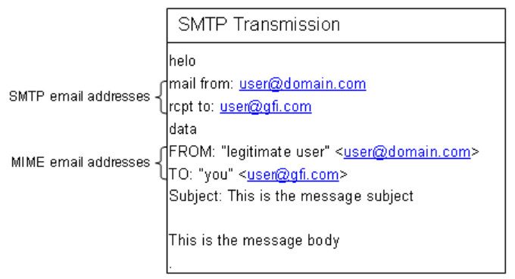
MIME – WHY?
Multipart Internet Mail Extensions – supports email messages other than ASCII Text. Thanks to that, we can send attachments and text in a format of HTML to recipients.
SMTP is text only
SMTP is limited in size

Slide 3
MIME Structure - Header
Mime Version - which version is the raw message
Content-Type - which type is represented in the body:
Text (text/plain, text/html..)
Image (image/png, image/jpeg..)
Audio (audio/mp3)
Video (video/mp4)
Application (application/msword)
Content-Disposition – specifies “location”. Mainly can be inline or attachment. Also can indicates the name of an attachment.
Content-Transfer-Encoding – Indicates how to parse / read the content in order to display it.
To..
From..
Subject…

Slide 4
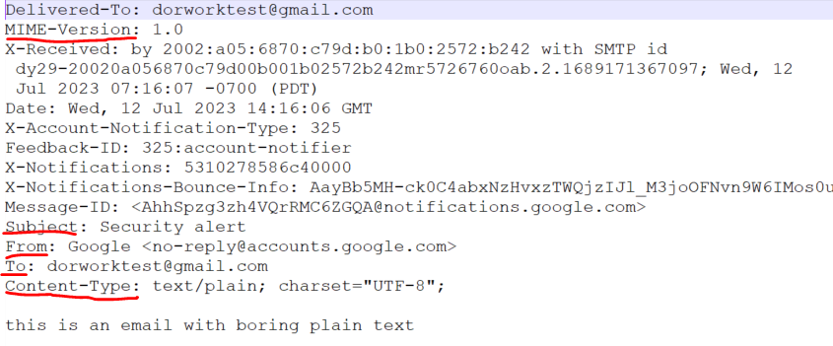
Header Example

Slide 5
MIME Structure - Body
The body of the mail can be one of the followings:
Simple (text, application, image, video…)
Multipart – meaning it contains more than one part. Each part has Header and Body as well. Those parts can be:
Alternative (multipart/alternative)
Related (multipart/related)
Mixed (multipart/mixed)
… There are more, not for this lecture.
Note: Here we will notice that the body of a MIME message is actually a tree.

Slide 6
Just a reminder to show how to download the raw mail message

Slide 7
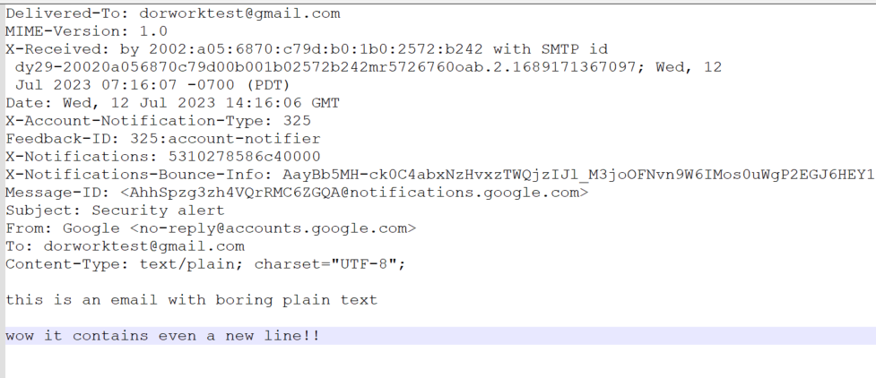
Simple Message Example
Header
Body

Slide 8
Multipart Alternative
We will use the multipart/alternative content-type when we want to give the email client (outlook, gmail…) more than one option to display the body. The most common use is when we have html body, but we want to give the option to display plain text body if the client, as old as it will be, cannot display HTML.
Header
Body
Header
text/plain
text/html

Slide 9
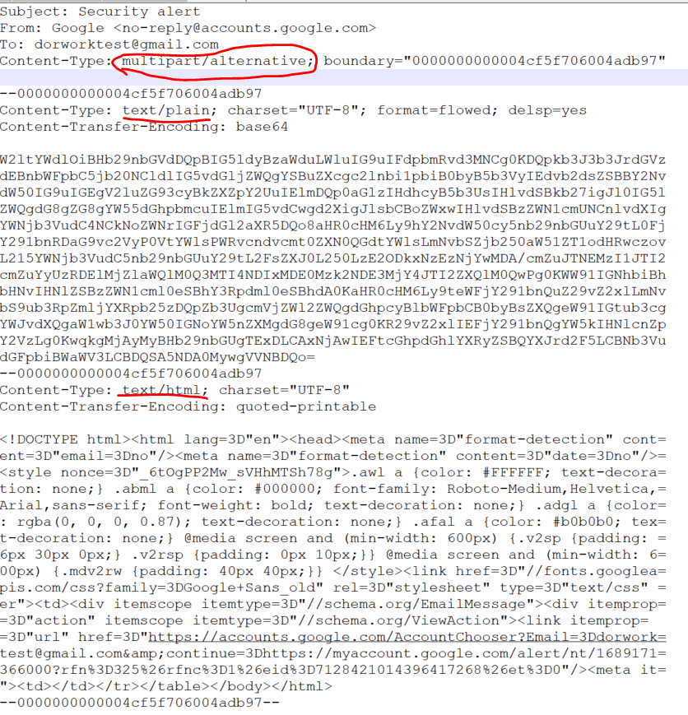
Multipart
Alternative
Example
Top Header
Header
Plain text
alternative part
Body
Header
HTML text
alternative part
Body

Slide 10

Before we continue to next multipart types… how do we know when parts start and end??

Slide 11
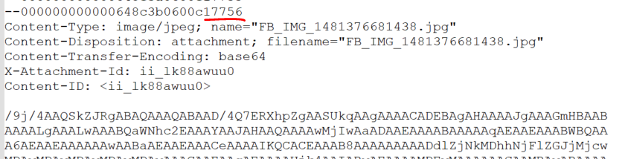
Boundaries
In order to know when part start and ends, in the content-type header of the part we have another indicator named “boundary”. It looks like that:
We know sub part is starting when the boundary is shown with prefix of “--”:
We know the whole part ending when the boundary is shown with prefix of “--” and suffix of “--”

Slide 12
Multipart Related
We will use the multipart/related content-type when several parts are related to each other. Most commons example: HTML with inline image

Slide 13
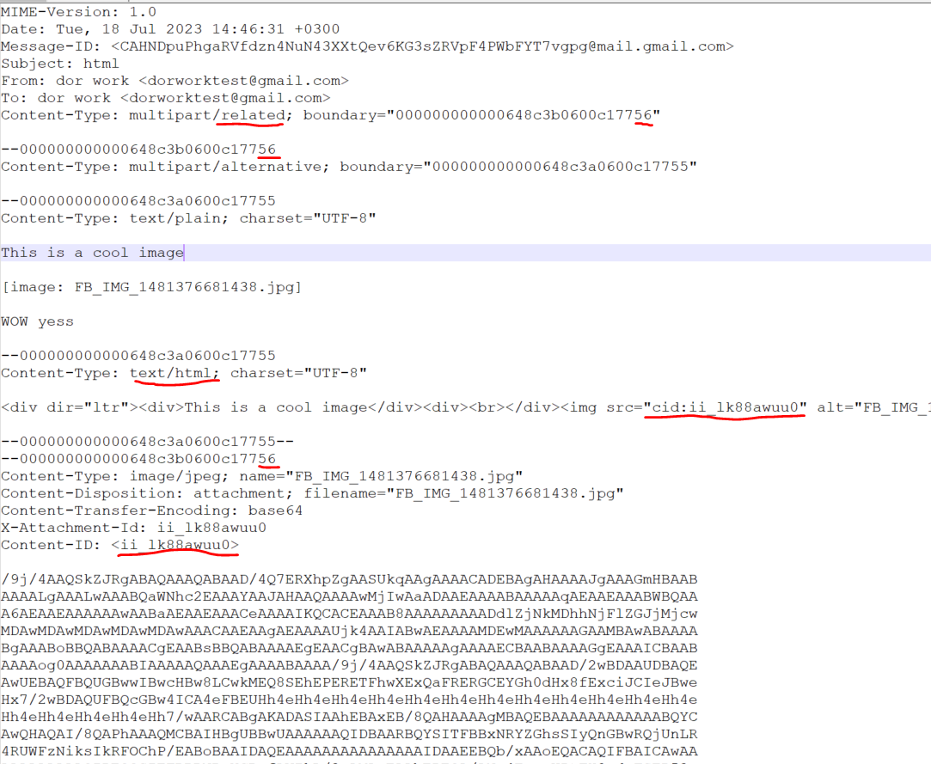

Multipart
Related
Example
Top Header
Related html part
Related jpg
image part

Slide 14
Multipart Mixed
We will use the multipart/mix content-type when several parts are should be together but are not related. Once example may be plain text and attachment

Slide 15
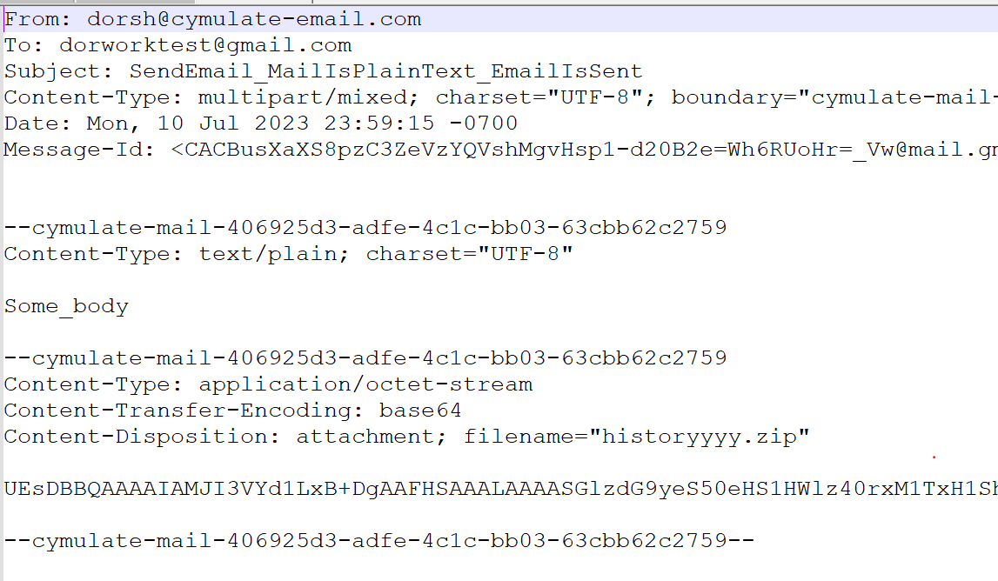
Multipart
Mixed
Example
Top Header
Mixed text part
Mixed attachment
part

Slide 16
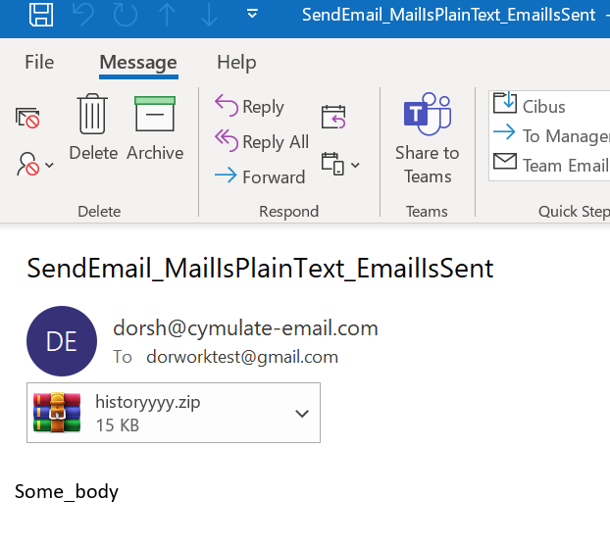
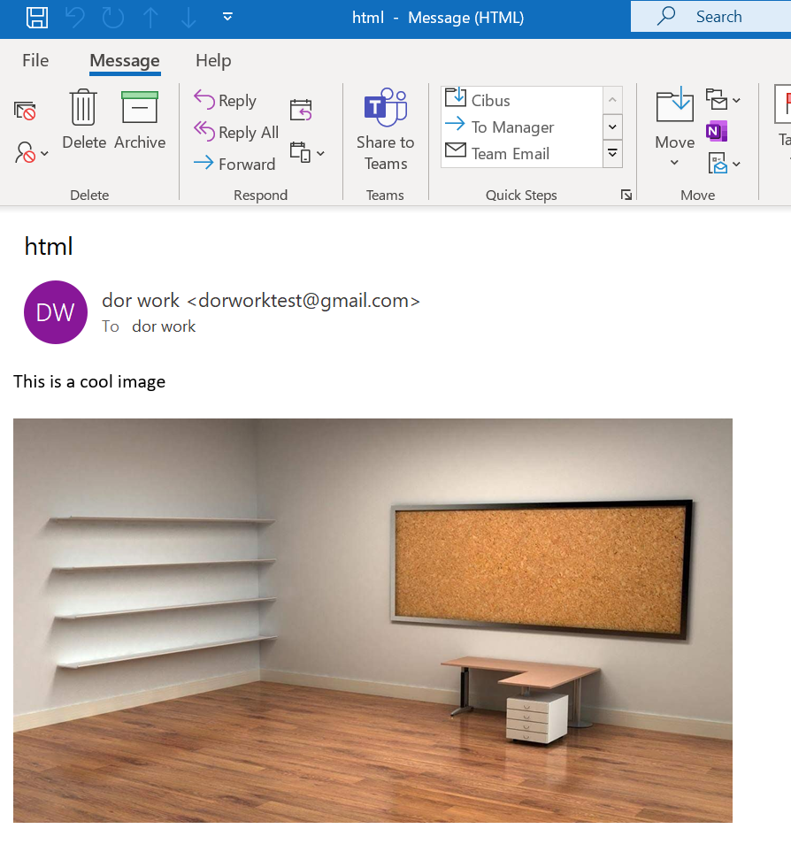
Attachments
There are two kinds of attachments:
Attachment Inline

Slide 17
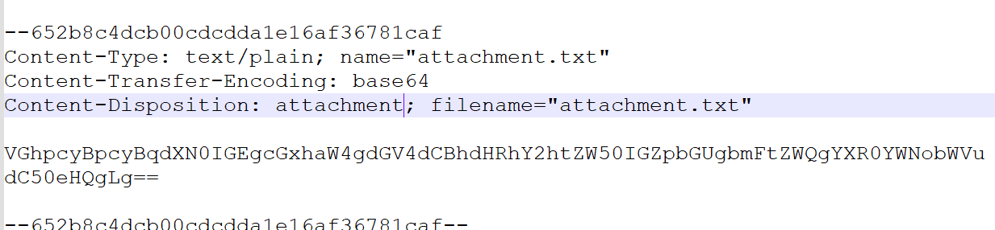
Attachments
Attachment type is indicated in the Content-Disposition header

Slide 18
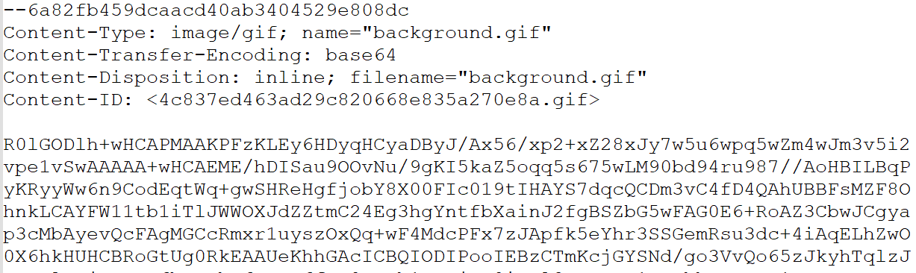
Attachments
Attachment type is indicated in the Content-Disposition header

Slide 19

Now – Test Time !
Draw me a tree
Which text will be displayed in the email client in the body?

